Slide 1
Responsive Design & SASS

Slide 2
AGENDA
Responsive Design
SASS
Flexbox

Slide 3
Responsive Design

Slide 4
1. Principles of Responsive Web Design
Number of Internet capable devices & screen has increased over the last few years
Challenge : designing web content that fits a plethora of screen widths & heights (viewports)
Different way of thinking : Web sites/applications adjust layout as width of screen changes
Ethan Marcotte, 2010
Responsive web design components : Fluid Grids, Media queries, Flexible images
Demos

Slide 5
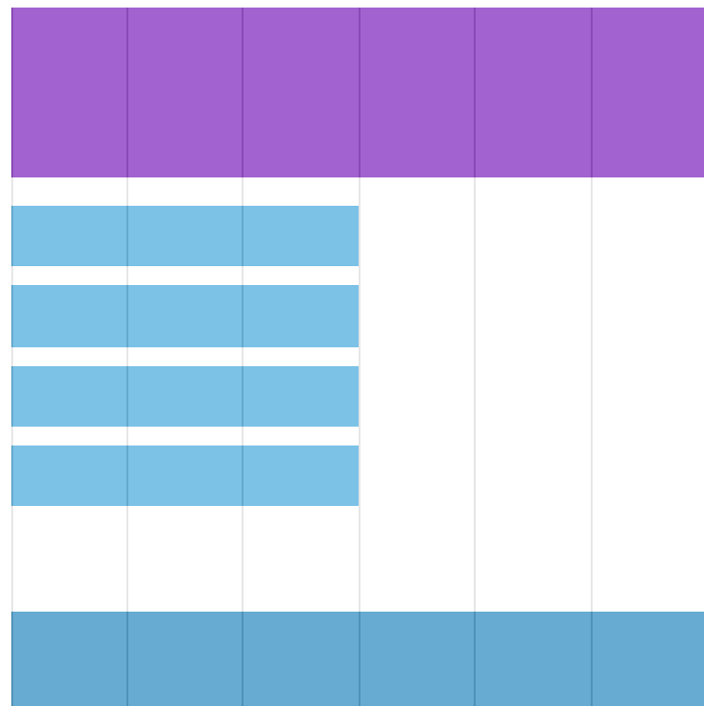
2. Fluid Grids for Responsive Design
Grid based design commonly used by web designers : flexible & respond to width of screen
Use of percentages in CSS maintains consistency in column width
Demos

Slide 6
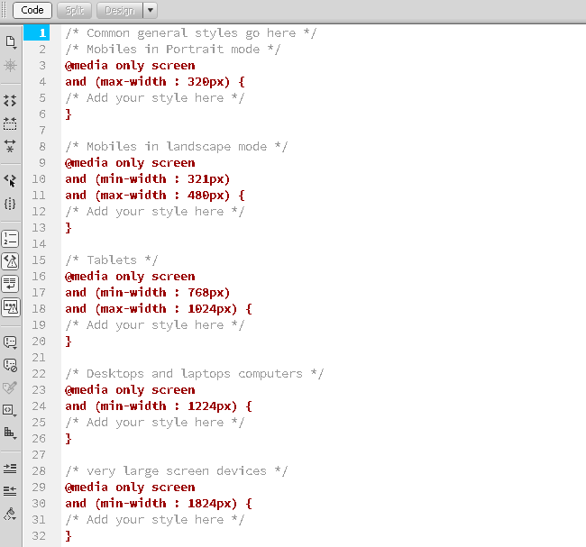
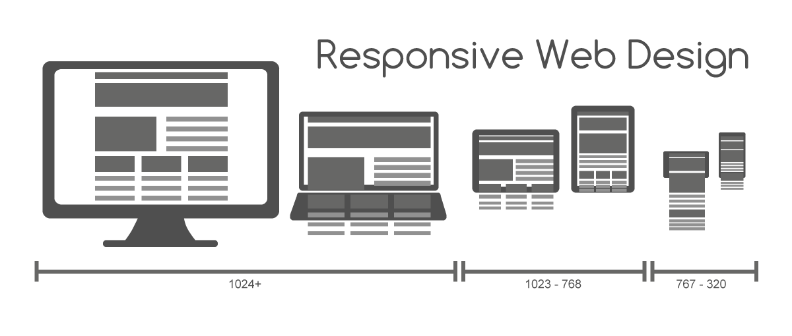
3. Media Queries for Responsive Design
Size-based conditional styling (CSS3)
Demos

Slide 7
4. Recommendations for Responsive Web Design
Align all elements to scalable grid
Consider proportions
Use Media Queries for applying different styles to application
Pay attention to navigation variations on possible devices
Design for smallest screen first

Slide 8
SASS (Syntactically Awesome Style Sheets)

Slide 9
What does SASS do for us?
Programmatic generation of CSS through a Preprocessor
More intuitive & concise structure
Less coding, deals with repetitive statements
Reusability
Consistency
Syntax variations
SASS (.sass) Syntactically Awesome Style Sheets
SCSS (.scss) Sassy Cascading Style Sheets

Slide 10
SASS Features
Nested Rules
Variables
Functions
Operators & Trigonometry
Code Flow and Control Statements (if statements)
Mixins

Slide 11
Flexbox

Slide 12
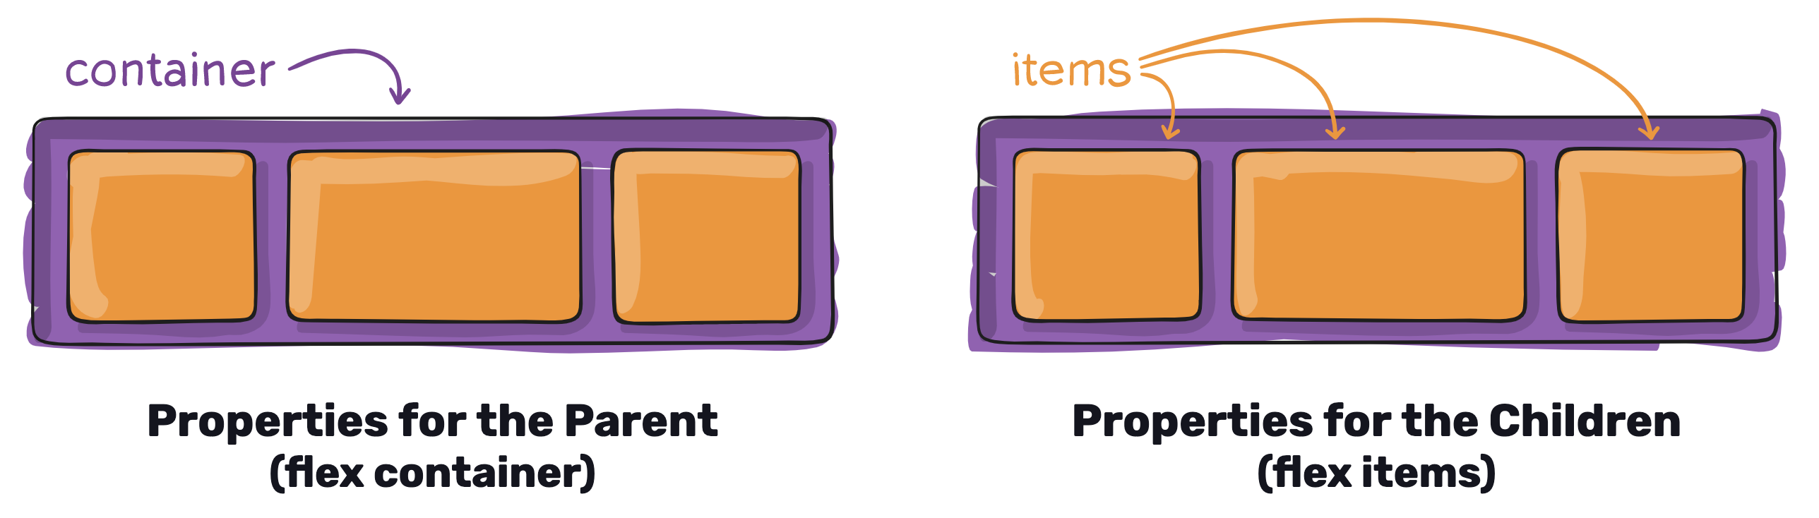
Flexbox
Flexbox Layout module
Ability to alter items' width/height (and order) to best fill (more efficient layout, alignment, distribution ) the available space in a container
More efficient for small-scale layouts, while the Grid layout is intended for larger scale layouts

Slide 13
Flexbox Properties
Flex Container
display : flex
flex-direction : row | column
flex-wrap : wrap | nowrap
justify-content : flex-start | center
align-items : flex-start | center
align-content : flex-start | center
Flex Item
order : <integer>
flex-grow : <integer>
flew-shrink : <integer>
flex : (grow & shrink together)
align-self : flex-start | center

